Slide 1
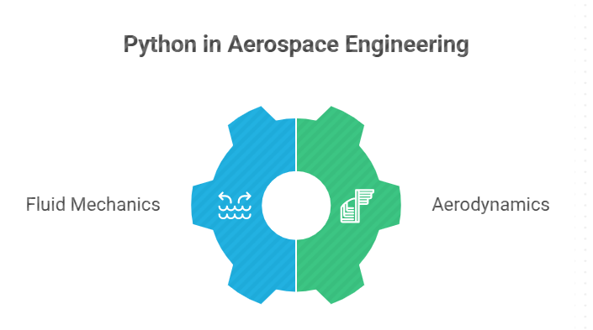
PYTHON FOR AEROSPACE
Applications in Fluid Mechanics and Aerodynamics
Presented by: Dr. Vigneswaran C.M.
Department of Aerospace Engineering
Ramaiah Institute of Technology

Slide 2
Python Basics – Data Structures

Slide 3
Contents

Slide 4
Contents
Installing python
Python Environment
Assignments & Naming Convention
Data Structures
Important Packages

Slide 5
Introduction to Python & History

Slide 6
What is python
It’s a multi purpose programming language
Open Source (Free)
Powerful scripting language with simple Syntax
Used by many data scientists and developers
Human-readable syntax and well Documented
www.python.org

Slide 7

History
Python language was developed by Guido van Rossum (Benevolent Dictator for
Life).

Slide 8
Python History
First Python version released in 1991
Python 2 was released in 2000
Python 3 was released in 2008
Python 3.4 (2014)
Python 3.6 (2016)
Python 3.9 (2020)
Python 3.11 (2022)
Python 3.12 (2023)
Python 3.13 (2024)

Slide 9
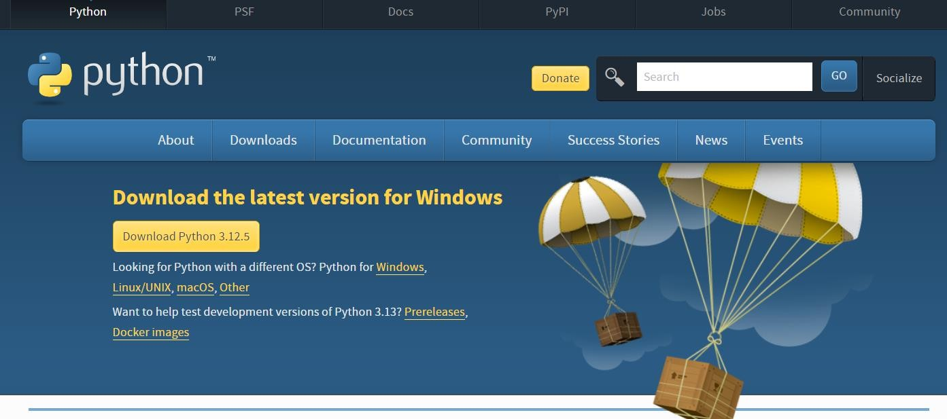
Which Version to install?
Usually latest stable version is preferred, not necessarily, latest version.

Slide 10
Installing Python & Python IDEs

Slide 11
Writing and executing python programs
Python has many options to write and execute a program
You can use Text Editors or Command line interfaces or Notebook or an IDE
Anaconda distribution has all the required software's inbuilt. We just
need to download and install it.

Slide 12
Installing Python, Anaconda
Download and install Anaconda
It automatically installs
  Ipython
  Jupyter notebook
  Spyder IDE(Integrated Development Environment)

Slide 13
Most Widely used IDEs
Data Science Projects
  Python Notebooks -Jupyter notebook/ Colab notebook
  Spyder
Software Development Projects
  Visual Studio Code (VS Code)
  PyCharm

Slide 14
Jypyter Notebook
Anaconda Navigator >>> Select Documents Folder >>> New Folder (name it python_notebooks) >>>New Notebook >>>Select Python3 Kernel >>Rename notebook(Introduction)

Slide 15
Colab Notebook
Search “Colab notebook” in google

Slide 16

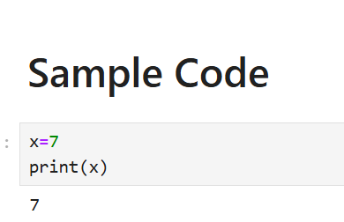
Working with notebooks
Add a text cell
Add a code cell

Slide 17
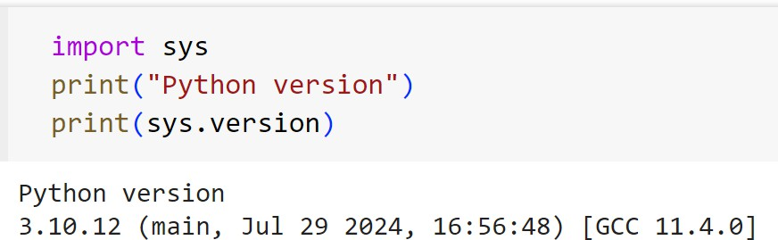
Check Python Version
import sys
print("Python version")
print(sys.version)
Anything above 3.10 is good

Slide 18
Before you code
Python is case sensitive
Be careful while using the Variable names and Function names
  Mach_Number is not same as Mach_number
  Print() is not same as print()

Slide 19
Basic Commands in Python

Slide 20
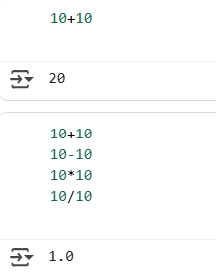
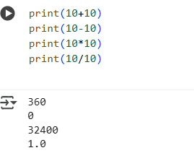
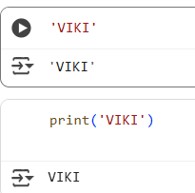
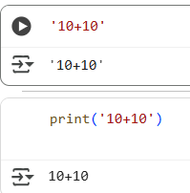
Basic Commands
.
Without print → only last line displays.
With print → all outputs display.
Anything inside single quotes ' ' or double quotes " " is a string

Slide 21
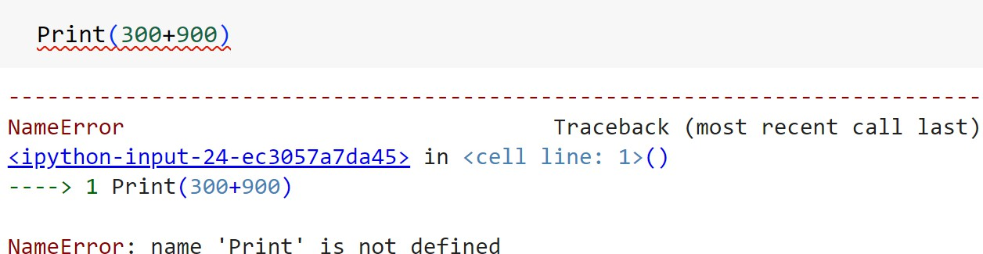
What an error looks like?
Typically the error messages are lengthy, look at the end of the message

Slide 22
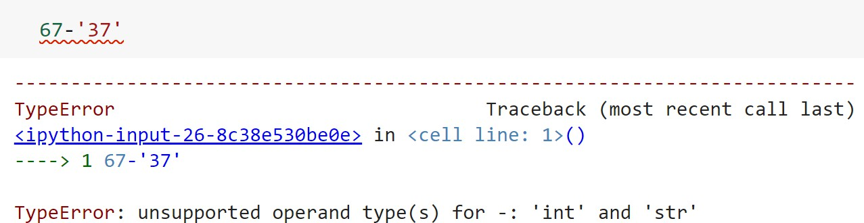
What an error looks like?
Typically the error messages are lengthy, look at the end of the message

Slide 23
Assigning and Naming convention

Slide 24
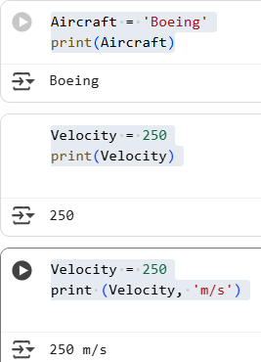
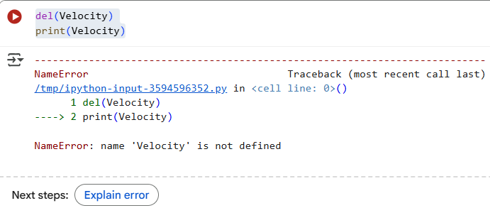
Assignment operator
del(Velocity) deletes the Velocity

Slide 25
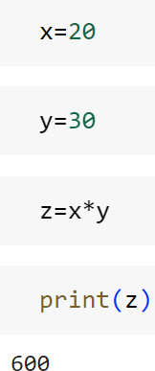
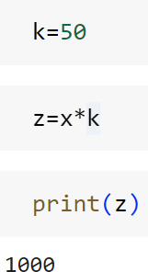
Assignment operator

Slide 26
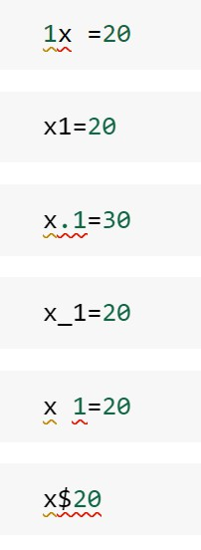
Naming convention
Must start with a letter (A-Z or a-z)
Can contain letters, digits (0-9), and/or
underscore “_”

Slide 27
Packages

Slide 28
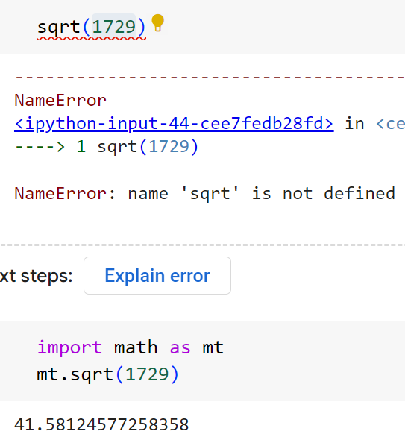
Packages
A package is collection of python functions. A properly structured and complied code. A package may contain many sub packages.
Many python functions are only available via “packages” that must be imported.
For example to find value of log(10) we need to first import math package that has the log function in it
For basic arithmetic operators (+ - * / // % **) you don’t need to import any math package in Python (or Colab). They are built-in operators.

Slide 29
Packages
To be a good data scientist on python, one need to be very comfortable
with below packages
  numpy
  scipy
  pandas
  scikit-Learn
  matplotlib
  nltk

Slide 30
Important Packages- NumPy
NumPy is for fast operations on vectors and matrices, including mathematical,
logical, shape manipulation, sorting, selecting.
It is the foundation on which all higher level tools for scientific Python packages are built
import numpy as np
income = np.array([9000, 8500, 9800, 12000, 7900, 6700, 10000])
print(income)
print(income[0])
expenses=income*0.65 print(expenses)
We will have a dedicated
session on Numpy
savings=income-expenses
print(savings)

Slide 31
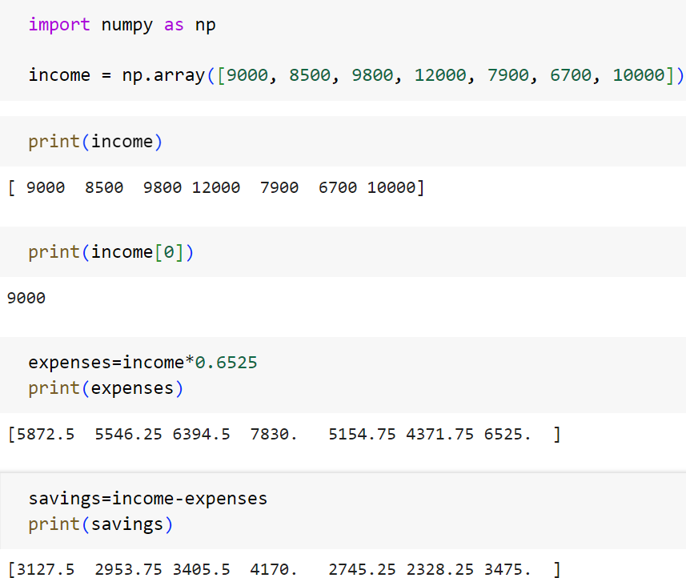

Slide 32
Important Packages- Pandas
Data frames and data handling
Pandas has Data structures and operations for manipulating numerical tables and time series.
import pandas as pd
Airfoil_data= pd.read_csv('C:\\Users\\viki\\Google Drive\\Training\\Datasets\\Airfoil_data.csv')
print(Airfoil_data)

Slide 33
Important Packages- Pandas
Data frames and data handling
Pandas has Data structures and operations for manipulating numerical tables and time series.
  import pandas as pd
  Airfoil_data = pd.read_csv('C:\\Users\\viki\\Google Drive\\Training\\Datasets\\Airfoil_data.csv')
  print(Airfoil_data)

Slide 34
Important Packages- Matplotlib
import matplotlib as mp
mp.pyplot.scatter(airfoil_data["AOA"],bank["CL"])

Slide 35
Important Packages- Scikit-Learn
Machine learning algorithms made easy
import sklearn as sk import pandas as pd
air = pd.read_csv("D:\\Google
Drive\\Training\\Datasets\\AirPassengers\\AirPassengers.csv")
air
from sklearn.linear_model import LinearRegression
lr = LinearRegression()
lr.fit(air[["Promotion_Budget"]], air[["Passengers"]])
We will be using this for ML
#Coefficients print(lr.coef_) print(lr.intercept_)

Slide 36
Get help on Python
Chat-GPT
Colab code generation
Stack Overflow
Official Documentation

Slide 37
Conclusion

Slide 38
Conclusion
In this session we got basic introduction to Python.
We tried some basic commands in Python

Slide 39
Python Basics – Data Structures

Slide 40
Contents
Data Structures
Numbers
Strings
Boolean
Lists
Tuples
Dictionaries
Sets
Loops and Conditionals
Functions

Slide 41
















Python Data Structures
Integer
Float
Primitive
String
Boolean
List
Tuple
Built-In
Dictionary
Set
Nonprimitive
Stack
Queue
User-Defined
LinkedList
Tree
All Data Structures

Slide 42
Python Data Structures
You have to use these almost in all programs
Integer
Float
Primitive
String
Boolean
All Data Structures
You may have to use these in several programs
List
Tuple
Built-In
Dictionary
Set
Nonprimitive
Stack
You can use these based on the need for some specific tasks.
Queue
User-Defined
LinkedList
Tree

Slide 43
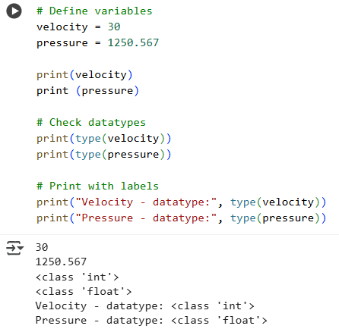
Integers and Float
# Define variables
velocity = 30
pressure = 1250.567
# Check datatypes
print(type(velocity))
print(type(pressure))
# Print with labels
print("Velocity - datatype:", type(velocity))
print("Pressure - datatype:", type(pressure))

Slide 44
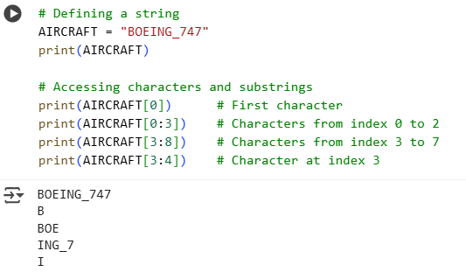
Strings
Strings are amongst the most popular types in Python.
String is a sequence of characters enclosed in either single quotes or double quotes
# Defining a string
AIRCRAFT = "BOEING_747"
print(AIRCRAFT)
# Accessing characters and substrings
print(AIRCRAFT[0]) # First character
print(AIRCRAFT[0:3]) # Characters from index 0 to 2
print(AIRCRAFT[3:8]) # Characters from index 3 to 7
print(AIRCRAFT[3:4]) # Character at index 3

Slide 45
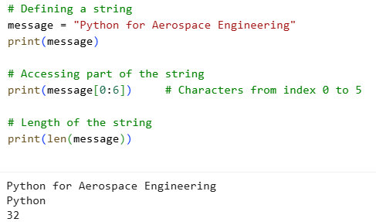
Strings – Slicing
# Defining a string
message = "Python for Aerospace Engineering"
print(message)
# Accessing part of the string
print(message[0:6]) # Characters from index 0 to 5
# Length of the string
print(len(message))

Slide 46
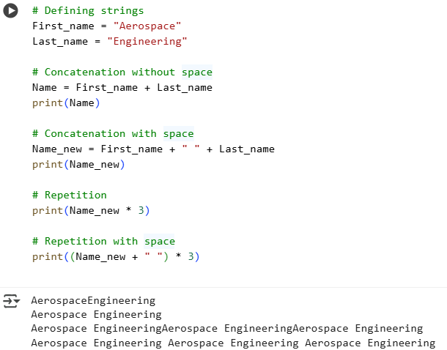
String Concatenation
# Defining strings
First_name = "Aerospace"
Last_name = "Engineering"
# Concatenation without space
Name = First_name + Last_name
print(Name)
# Concatenation with space
Name_new = First_name + " " + Last_name
print(Name_new)
# Repetition
print(Name_new * 3)
# Repetition with space
print((Name_new + " ") * 3)

Slide 47
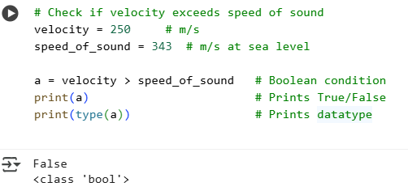
Boolean
Used to store and return the values True an False.
Useful for comparison operations
# Check if velocity exceeds speed of sound
velocity = 250 # m/s
speed_of_sound = 343 # m/s at sea level
a = velocity > speed_of_sound # Boolean condition
print(a) # Prints True/False
print(type(a)) # Prints datatype

Slide 48
Different kinds of brackets (or delimiters)
Bracket Type | Symbol | Main Usage
Parentheses | ( ) | Functions, tuples, grouping
Square brackets | [ ] | Lists, indexing, slicing
Curly braces | { } | Dicts, sets, comprehensions
Angle brackets | < > | Comparisons, type hints (rare)
Triple quotes | ''' """ | Multi-line strings, docstrings

Slide 49
Python Data Structures
Integer
Float
Primitive
String
Boolean
List
Tuple
Built-In
Dictionary
Set
Nonprimitive
Stack
Queue
User-Defined
LinkedList
Tree
All Data Structures

Slide 50

Python Data Structures
Integer
Float
Primitive
String
Boolean
List
Tuple
Built-In
Dictionary
Set
Nonprimitive
Stack
Queue
User-Defined
LinkedList
Tree
All Data Structures

Slide 51
List
A sequence or a collection of elements.
A list looks similar to an array, but not array
Lists, can contain any number of elements. The elements of a list need not be of the same type

Slide 52
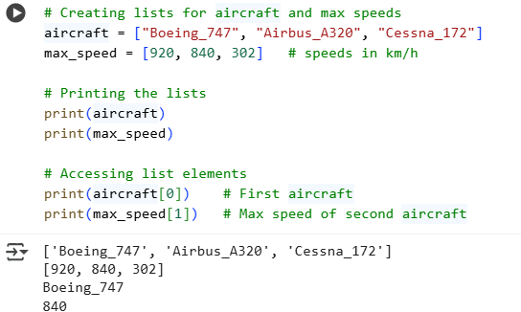
List Creation
# Creating lists for aircraft and max speeds
aircraft = ["Boeing_747", "Airbus_A320", "Cessna_172"]
max_speed = [920, 840, 302] # speeds in km/h
# Printing the lists
print(aircraft)
print(max_speed)
# Accessing list elements
print(aircraft[0]) # First aircraft
print(max_speed[1]) # Max speed of second aircraft

Slide 53
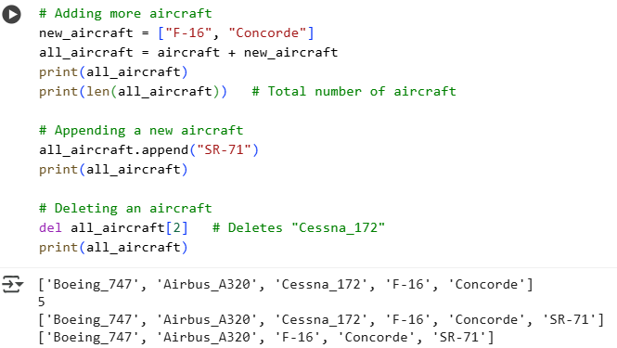
Combining two lists
# Adding more aircraft
new_aircraft = ["F-16", "Concorde"]
all_aircraft = aircraft + new_aircraft
print(all_aircraft)
print(len(all_aircraft))
# Appending a new aircraft
all_aircraft.append("SR-71")
print(all_aircraft)
# Deleting an aircraft
del all_aircraft[2] # Deletes "Cessna_172"
print(all_aircraft)

Slide 54
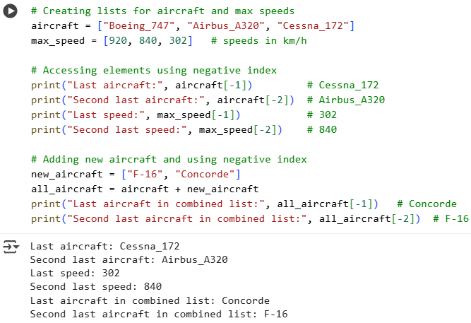
Negative Index
# Creating lists for aircraft and max speeds
aircraft = ["Boeing_747", "Airbus_A320", "Cessna_172"]
max_speed = [920, 840, 302]
# Accessing elements using negative index
print("Last aircraft:", aircraft[-1])
print("Second last aircraft:", aircraft[-2])
print("Last speed:", max_speed[-1])
print("Second last speed:", max_speed[-2])

Slide 55
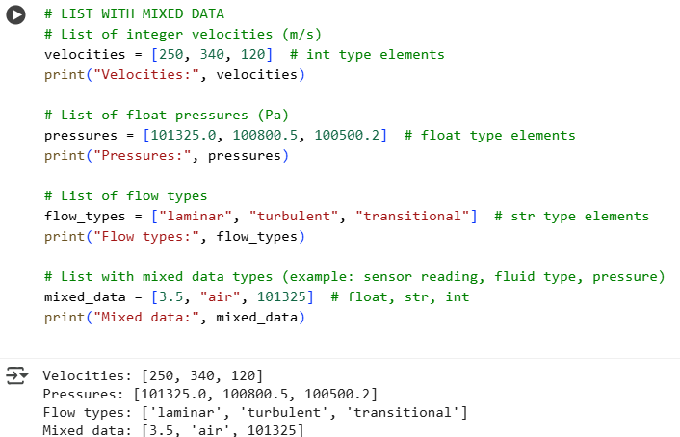
LIST WITH MIXED DATA
# List with mixed data types
(example: sensor reading, fluid type, pressure)
mixed_data = [3.5, "air", 101325]
# float, str, int
print("Mixed data:", mixed_data)

Slide 56
Python Data Structures
Integer
Float
Primitive
String
Boolean
List
Tuple
Built-In
Dictionary
Set
Nonprimitive
Stack
Queue
User-Defined
LinkedList
Tree
All Data Structures

Slide 57
Python Data Structures
Integer
Float
Primitive
String
Boolean
All Data Structures
List
Tuple
Dictionary
Built-In
Set
Nonprimitive
Stack
Queue
User-Defined
LinkedList
Tree

Slide 58
Tuples
Tuple is one of 4 built-in data types in Python
Collection of items stored in a single variable
Items inside a tuple can be homogeneous or heterogenous.
Tuples are sequences, just like lists. There are some major differences between tuples and lists.
Tuples are immutable. We can NOT update or change the values of tuple elements

Slide 59
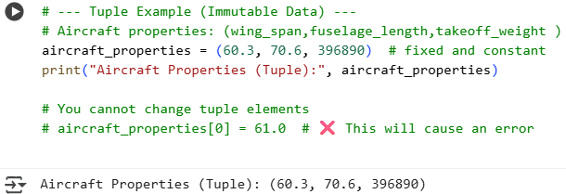
Tuples
# --- Tuple (Immutable Data) ---
# Aircraft properties: (wing_span in m, fuselage_length in m, max_takeoff_weight in kg)
aircraft_properties = (60.3, 70.6, 396890) # fixed and constant
print("Aircraft Properties (Tuple):", aircraft_properties)
# You cannot change tuple elements
# aircraft_properties[0] = 61.0
# ❌ This will cause an error

Slide 60
Python Data Structures
Integer
Float
Primitive
String
Boolean
List
Tuple
Built-In
Dictionary
Set
Nonprimitive
Stack
Queue
User-Defined
LinkedList
Tree
All Data Structures

Slide 61







Python Data Structures
Integer
Float
Primitive
String
Boolean
List
All Data Structures
Tuple
Dictionary
Set
Built-In
Nonprimitive
Stack
Queue
User-Defined
LinkedList
Tree

Slide 62
Dictionaries
Dictionaries have two major element types key and Value.
Dictionaries are collection of key value pairs
Each key is separated from its value by a colon (:), the items are separated by commas, and the whole thing is enclosed in curly braces.
Keys are unique within a dictionary

Slide 63
Dictionaries
# Defining a dictionary for air properties
air_properties = {
"density": 1.225, # kg/m^3
"viscosity": 1.81e-5, # Pa.s
"specific_heat": 1005 # J/(kg·K) }
# Accessing values using keys
print("Air density:", air_properties["density"], "kg/m^3")
print("Air viscosity:", air_properties["viscosity"], "Pa.s")
print("Specific heat:", air_properties["specific_heat"], "J/(kg·K)")
# Adding a new property
air_properties["pressure"] = 101325
print("Updated Air Properties:", air_properties)

Slide 64
Dictionaries
# Define dictionary for air properties
air_properties = {"density": 1.225, "viscosity": 1.81e-5,
"specific_heat": 1005 }
# Change the value of an existing key
air_properties["density"] = 1.2 # Updated density
print("Updated density:", air_properties["density"])
# Add a new key-value pair
air_properties["pressure"] = 101325
print("Added pressure:", air_properties["pressure"])
# Change a key (create new key and delete old one)
air_properties["air_density"] = air_properties.pop("density")
print("Changed key from 'density' to 'air_density':", air_properties)

Slide 65
Conditionals, Loops and functions

Slide 66
Contents

Slide 67
Contents
Functions
Conditionals
Loops

Slide 68
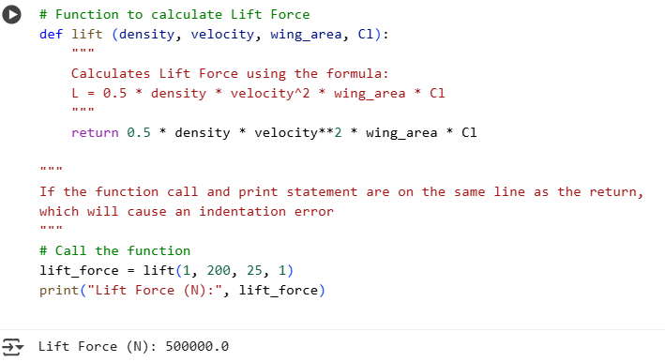
Functions
# Function to calculate Lift Force
def lift (density, velocity, wing_area, Cl):
return 0.5 * density * velocity**2 * wing_area * Cl
# If the function call and print statement are on the same line as the return, which will cause an indentation error.
# Call the function
lift_force = lift(1, 200, 25, 1)
print("Lift Force (N):", lift_force)

Slide 69
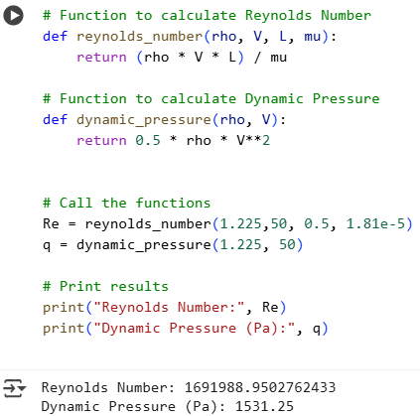
Functions
# Function to calculate Reynolds Number
def reynolds_number(rho, V, L, mu):
return (rho * V * L) / mu
# Function to calculate Dynamic Pressure
def dynamic_pressure(rho, V):
return 0.5 * rho * V**2
# Call the functions
Re = reynolds_number(1.225,50, 0.5, 1.81e-5)
q = dynamic_pressure(1.225, 50)
# Print results
print("Reynolds Number:", Re)
print("Dynamic Pressure (Pa):", q)

Slide 70
Different kinds of brackets (or delimiters)
Bracket Type | Symbol | Main Usage
Parentheses | ( ) | Functions, tuples, grouping
Square brackets | [ ] | Lists, indexing, slicing
Curly braces | { } | Dicts, sets, comprehensions
Angle brackets | < > | Comparisons, type hints (rare)
Triple quotes | ''' """ | Multi-line strings, docstrings

Slide 71
If-Else statement

Slide 72
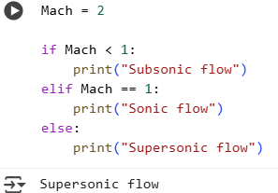
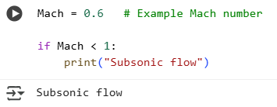
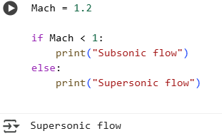
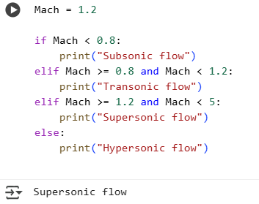
If-else Condition
Indentation is required in Python for if, elif, and else blocks

Slide 73
For loop

Slide 74
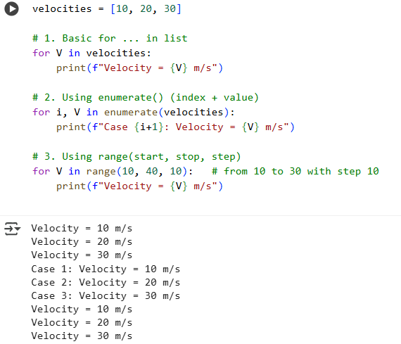
For loop
velocities = [10, 20, 30]
# 1. Basic for ... in list
for V in velocities:
print(f"Velocity = {V} m/s")
# 2. Using enumerate() (index + value)
for i, V in enumerate(velocities):
print(f"Case {i+1}: Velocity = {V} m/s")
# 3. Using range(start, stop, step)
for V in range(10, 40, 10): # from 10 to 30 with step 10
print(f"Velocity = {V} m/s")
f-string (formatted string literal) allows us to insert variable values directly inside a string by writing them in curly braces { }.

Slide 75
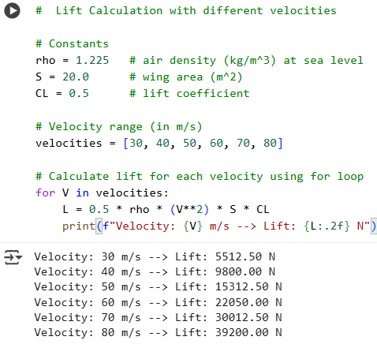
For loop
# Lift Calculation with different velocities
# Constants
rho = 1.225 # air density (kg/m^3) at sea level
S = 20.0 # wing area (m^2)
CL = 0.5 # lift coefficient
# Velocity range (in m/s)
velocities = [30, 40, 50, 60, 70, 80]
# Calculate lift for each velocity using for loop
for V in velocities:
L = 0.5 * rho * (V**2) * S * CL
print(f"Velocity: {V} m/s --> Lift: {L:.2f} N")

Slide 76
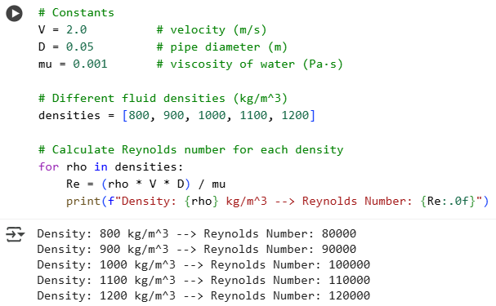
For loop
# Constants
V = 2.0 # velocity (m/s)
D = 0.05 # pipe diameter (m)
mu = 0.001 # viscosity of water (Pa·s)
# Different fluid densities (kg/m^3)
densities = [800, 900, 1000, 1100, 1200]
# Calculate Reynolds number for each density
for rho in densities:
Re = (rho * V * D) / mu
print(f"Density: {rho} kg/m^3 --> Reynolds Number: {Re:.0f}")
Don’t reuse the same name for the list and the loop variable. Use something like for r in rho:

Slide 77
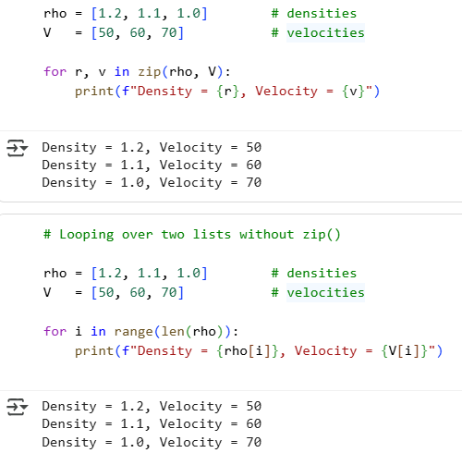
Looping over two lists
# Looping over two lists with zip()
rho = [1.2, 1.1, 1.0] # densities
V = [50, 60, 70] # velocities
for r, v in zip(rho, V):
print(f"Density = {r}, Velocity = {v}")
# Looping over two lists without zip()
for i in range(len(rho)):
print(f"Density = {rho[i]}, Velocity = {V[i]}")
Not mandatory to use zip(), but it’s Pythonic and safer.

Slide 78
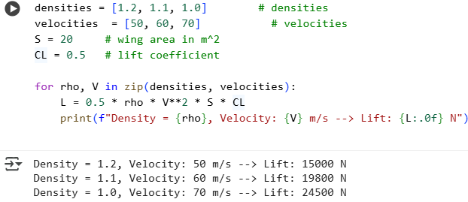
Looping over two lists
densities = [1.2, 1.1, 1.0] # densities
velocities = [50, 60, 70] # velocities
S = 20 # wing area in m^2
CL = 0.5 # lift coefficient
for rho, V in zip(densities, velocities):
L = 0.5 * rho * V**2 * S * CL
print(f"Density = {rho}, Velocity: {V} m/s --> Lift: {L:.0f} N")
zip() is used to pair elements one-to-one from two or more lists.
If you want every density with every velocity, not one-to-one.
Then, use a nested loop: the outer loop goes over densities, the inner loop goes over velocities.

Slide 79
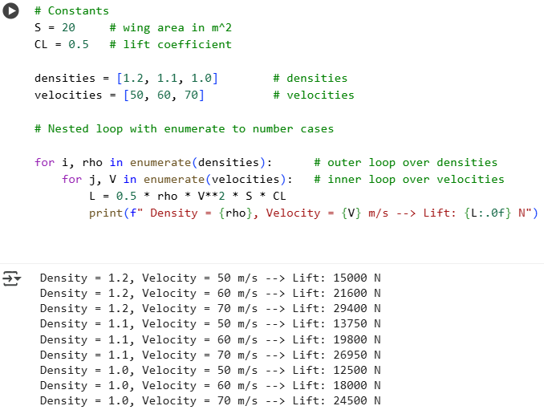
Nested for loop
# Constants
S = 20 # wing area in m^2
CL = 0.5 # lift coefficient
densities = [1.2, 1.1, 1.0] # densities
velocities = [50, 60, 70] # velocities
# Nested loop with enumerate to number cases
for i, rho in enumerate(densities): # outer loop over densities
for j, V in enumerate(velocities): # inner loop over velocities
L = 0.5 * rho * V**2 * S * CL
print(f" Density = {rho}, Velocity = {V} m/s --> Lift: {L:.0f} N")

Slide 80
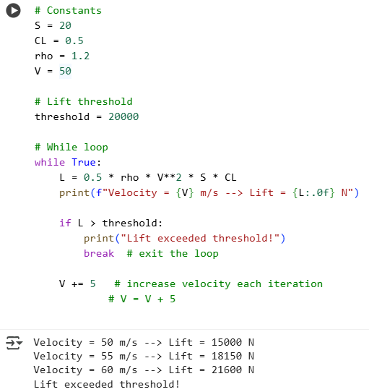
While loop
# Constants
S = 20
CL = 0.5
rho = 1.2
V = 50
# Lift threshold
threshold = 20000
# While loop
while True:
L = 0.5 * rho * V**2 * S * CL
print(f"Velocity = {V} m/s --> Lift = {L:.0f} N")
if L > threshold:
print("Lift exceeded threshold!")
break # exit the loop
V += 5 # increase velocity each iteration
# V = V + 5

Slide 81
math

Slide 82
Math package
By default, Python only has basic arithmetic operators (+ - * / ** %) available without importing anything.
Functions like sqrt(), log(), sin(), etc. are not available directly unless you import them from:
math package (built-in, works on single numbers)
What is the math package?
A built-in Python module (no extra installation needed).
Provides basic mathematical functions that work on single numbers (scalars).
Very similar to the functions you use on a scientific calculator

Slide 83
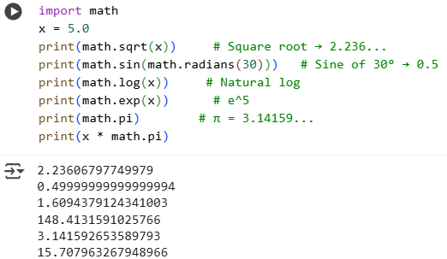
Math package
import math
x = 5.0
print(math.sqrt(x)) # Square root → 2.236...
print(math.sin(math.radians(30))) # Sine of 30° → 0.5
print(math.log(x)) # Natural log
print(math.exp(x)) # e^5
print(math.pi) # π = 3.14159...
print(x * math.pi)

Slide 84
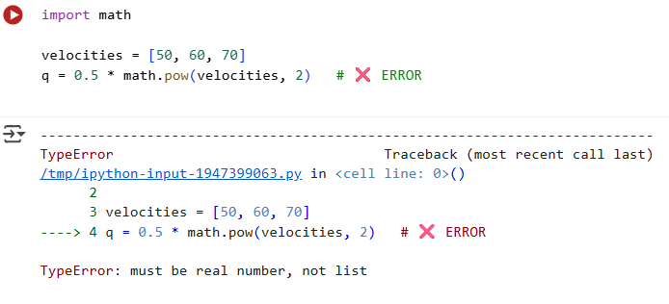
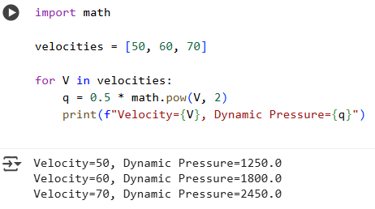
Math package
Limitations of math in Python
Works only with scalars (single numbers)
  math.sqrt(25) ✅ works
  math.sqrt([1, 4, 9]) ❌ error
  If you have a list/array, you must loop through it manually.
Conclusion:
math → only works with scalars
You can still use it with lists, but only if you loop through values one-by-one.
If you want to apply formulas to an entire list/array at once → that’s where NumPy comes in

Slide 85
numpy

Slide 86
Numpy package
NumPy stands for Numerical Python.
It provides efficient tools for handling arrays and matrices.
It is faster and more memory-efficient than Python lists, especially for large datasets.
Used for mathematical operations, linear algebra, statistics, and simulations.
Why use NumPy in Aerospace / Fluid Mechanics?
Storing densities, velocities, pressures as arrays.
Performing vectorized calculations (no loops needed).
Calculating Reynolds number, lift, drag, or pressure coefficients quickly for many points.
Easy integration with plotting libraries like Matplotlib.

Slide 87
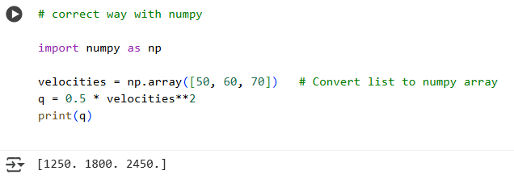
Numpy
Because:
Python lists ([50, 60, 70]) don’t support element-wise math.
velocities**2 is not defined for lists.
Correct way with NumPy →

Slide 88
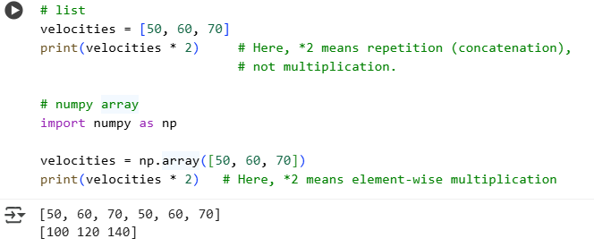
Numpy
With a Python list
# list
velocities = [50, 60, 70]
print(velocities * 2)
# Here, *2 means repetition (concatenation), not multiplication.
2. With a NumPy array
# numpy array
import numpy as np
velocities = np.array([50, 60, 70])
print(velocities * 2)
# Here, *2 means element-wise multiplication

Slide 89
Numpy
✅ Covered Topics
Array creation – np.array, np.zeros, np.eye, np.random.rand
Basic arithmetic – + - * /, element vs matrix multiplication (@)
Transpose – .T
Matrix operations – det, inv, eig
Linear equations – np.linalg.solve
Polynomials – np.roots, np.polyval
Broadcasting – e.g., rho[:, np.newaxis] * V**2
Vectorized calculations – lift, dynamic pressure, etc.
Trigonometric / sqrt / log / exp – works on scalars or arrays
Optional / Advanced NumPy Topics (newer / extra)
Stacking arrays: np.vstack, np.hstack
Reshaping arrays: np.reshape, np.ravel
Indexing & slicing: arr[::2], arr[:,1]
Boolean masking: arr[arr > 50]
Statistical functions: np.mean, np.std, np.sum, np.max
Linear algebra extensions: np.linalg.norm, np.linalg.eigvals, np.linalg.svd
Polynomial fitting: np.polyfit(x, y, deg) → e.g., fit a curve to data
Random sampling / distributions: np.random.normal, np.random.randint

Slide 90
pandas package
Pandas is a Python library for data analysis and manipulation.
Built on NumPy, so it’s fast with arrays and numerical operations.
Provides two main data structures:
Series → 1D labeled array (like a column of data)
DataFrame → 2D labeled table (like an Excel sheet)
Handle experimental data: velocity, pressure, temperature, density.
Compute derived quantities: lift, drag, Reynolds number.
Easy filtering, grouping, statistics, plotting.
Read/write CSV, Excel or even online datasets.

Slide 91
Thank you

